Slide 1
CEF 440: INTERNET AND MOBILE PROGRAMMING

Slide 2
TABLE OF CONTENTS
01
04
Conclusion
Lists of abbreviations
02
05
Introduction
References
03
06
Mobile app development process
Lists of tableaux

Slide 3
Lists of abbreviations
GOSTUDIO
APIs: Application of Programming Interfaces
Cpp: C plus plus
CSS: Cascading style sheet
HTML: Hypertext Markup Language
JS: JavaScript
KPIs: Key Performance Indicator
TS: TypeScript
UI: User interface
UX: user experience

Slide 4
Introduction
A mobile application or app is a computer program or software application designed to run on a mobile device such as a phone, tablet, or watch.
It can be classified in 3 categories:
1)Native applications
2)Web applications
3)Hybrid applications

Slide 5
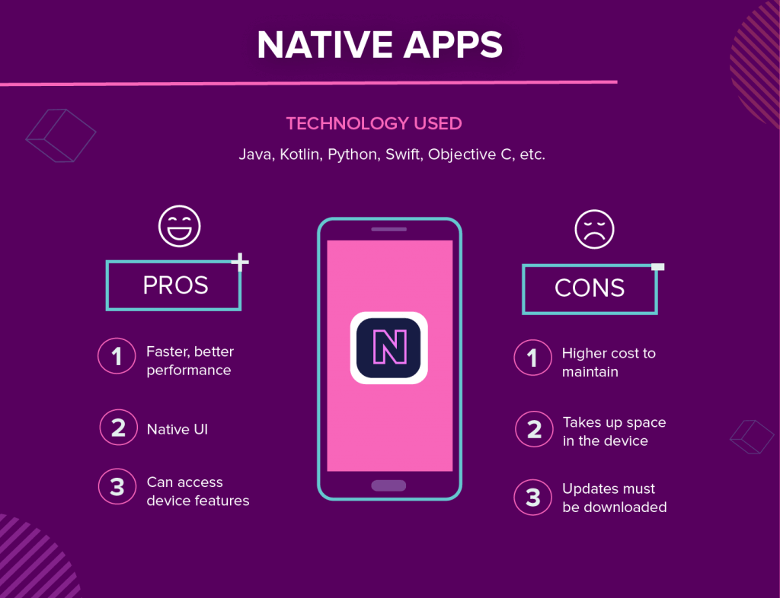
Native App
Hybrid apps are native applications with a web browser embedded inside them (e.g.: Facebook,
Instagram, Gmail, Discord).

Slide 6
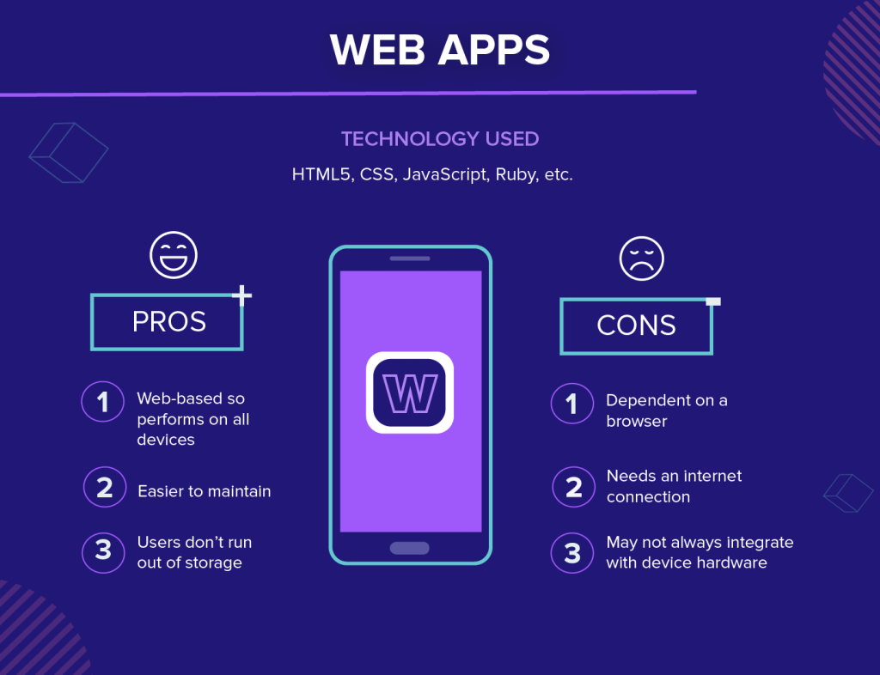
Web App
A web application is application software that is accessed using a web browser. Web applications are delivered on the World Wide Web to users with an active network connection.

Slide 7
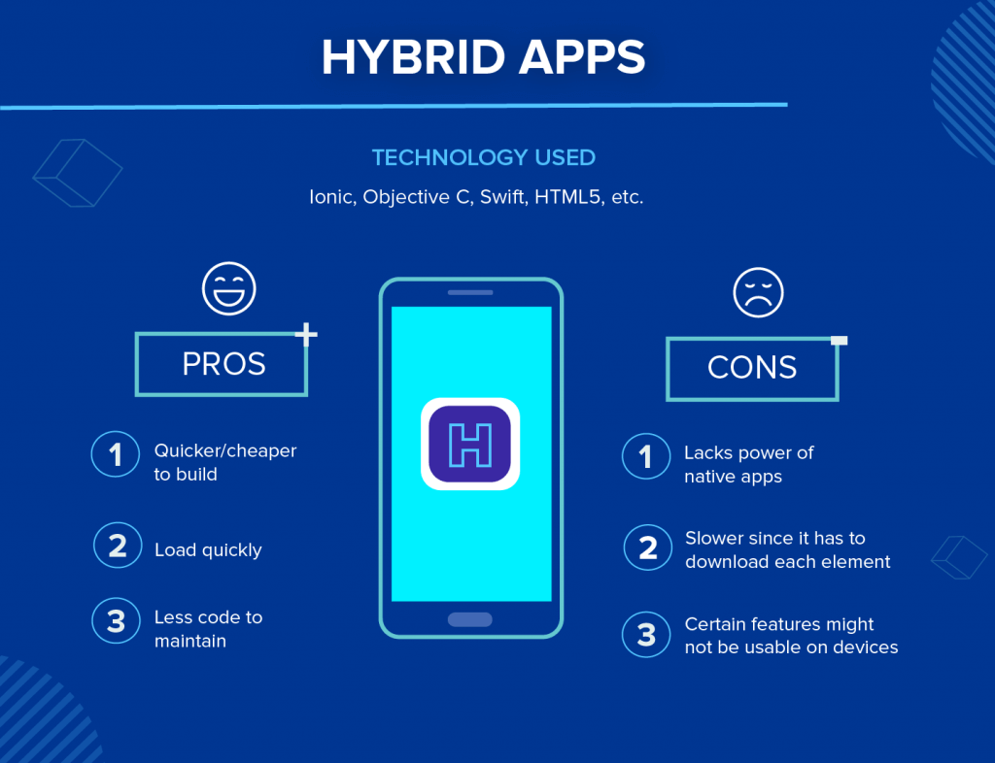
Hybrid App
Hybrid apps are native applications with a web browser embedded inside them (e.g.: Facebook,
Instagram, Gmail, Discord).

Slide 8
Mobile app programming languages
The programming languages commonly used for mobile application development are:
PYTHON
JAVASCRIPT
c#
Java
Swift
Kotlin
Dart

Slide 9
Programming language | platform | Operating system | Level of difficulty | Framework | Programmer experience
javascript | Hybrid app Web apps | Android and IOS | Easy to learn | React native | beginner
kotlin | Native app | Android | Easy to learn | Native android SDK | beginner
Java | Native app | Android | Easy to learn |  | intermediate
Swift | Native app | IOS | Easy to learn | Native IOs | beginner
Objective-C | Native app | IOS | Easy to learn | - | beginner
C# | Hybrid apps | Android and IOS | intermediate | Xamarin | intermediate
Dart | Hybrid apps | Android and IOS | Easy to learn | Flutter | beginner
Python | Hybrid apps | Android & ios | One of the easiest PL | kivy | beginner
C++ | Hybrid apps | Android & IOS | Hard to learn | Microsoft tool in VS | professional

Slide 10
Mobile app development frameworks
The mobile app development frameworks commonly used for mobile are:
Flutter
React native
Xamarin
NativeScript
Ionic
Native android

Slide 11
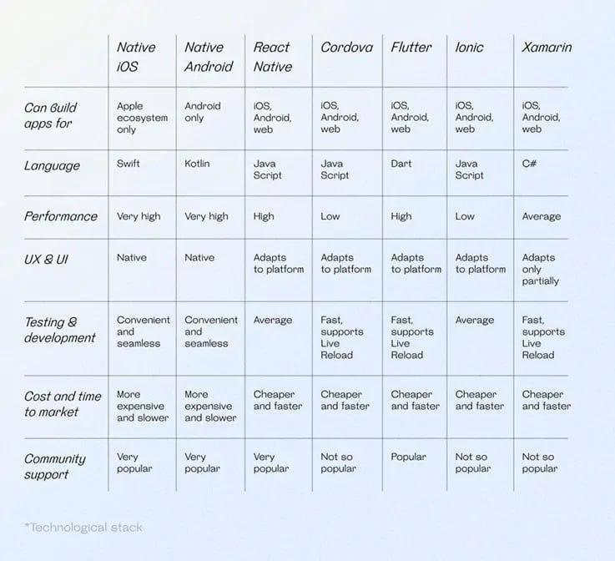

Slide 12
Mobile application architecture and design patterns
Mobile application architectures and design patterns play a crucial role in organizing and structuring the codebase, improving maintainability, and enhancing the overall performance of mobile
Apps.
Here are some common mobile application architectures and design patterns:
•Model-View-Controller (MVC)
•Model-View-ViewModel (MVVM)
•Clean Architecture
•Single-Page Application (SPA)
•Microservices Architecture

Slide 13
Collect and analyze user requirements
You can use various methods, such as surveys, interviews, focus groups, personas, user stories, and user journeys, to collect and analyze data about the users.
Basically, there are 7 key steps for gathering good app requirements that can be
listed as follow:
•Identify the key stakeholders
•Understand the business needs
•Identify the user requirements
•Define the functional requirements
•Define the technical requirements
•Prioritize the requirements
•Document the requirements

Slide 14
Mobile app development cost estimation
The price of building an app highly depends on its functionality and the wages of those who are going to build it. Every feature takes a number of hours to program, and the more complex the app, the higher will be the price of building and maintaining it after release.

Slide 15
Mobile app development cost estimation
Key determinate of development cost:
-App complexity and functionality
-Targeted platforms
-UI/UX design
-Backend development
-development team structure

Slide 16
Cost estimation process
•Define App Requirements: Clearly define the app's features, functionalities, and target audience.
•Break Down the Development Process: The development process typically involves stages like
discovery, design, development, testing, and deployment. Estimate the time required for each stage.
•Consider Development Team Structure: Decide whether to outsource development to a freelancer,
agency, or build an in-house team. Factor in their hourly rates.
•Additional Costs: Account for ongoing costs like app store fees, maintenance, and server costs .
Insert your multimedia content here

Slide 17
Conclusion
In conclusion, mobile app development encompasses different types of apps, including native, web,and hybrid, which utilize programming languages like Swift, Objective-C, Java, Kotlin, HTML, CSS,and JavaScript, along with frameworks such as React Native and Flutter. Architectural patterns like MVC, MVVM, and Clean Architecture help organize the app's structure. Analyzing user requirements
is crucial for defining functionalities and designing a seamless user experience. The choice of programming language depends on factors such as the target platform, development resources,performance requirements, and the desired level of access to device capabilities. So overall, it’s just important to remember that work doesn’t stop once your app has been deployed. In fact, it’s only
starting.

Slide 18
THANKS!
Does anyone have any question?

Slide 19
Fonts & colors used
This presentation has been made using the following fonts:
Roboto
(https://fonts.google.com/specimen/Roboto+bold)
Roboto
(https://fonts.google.com/specimen/Roboto+Thin)
#48ffd5
#0e2a47
#ffffff

Slide 20





Storyset
Create your Story with our illustrated concepts. Choose the style you like the most, edit its colors, pick the background and layers you want to show and bring them to life with the animator panel! It will boost your presentation. Check out How it Works.
Pana
Amico
Bro
Rafiki
Cuate

Slide 21
Use our editable graphic resources...
You can easily resize these resources without losing quality. To change the color, just ungroup the resource and click on the object you want to change. Then, click on the paint bucket and select the color you want. Group the resource again when you’re done. You can also look for more infographics on Slidesgo.

Slide 23
JANUARY
FEBRUARY
MARCH
APRIL
MAY
JUNE
PHASE 1
Task 1
Task 2
PHASE 2
Task 1
Task 2
JANUARY
FEBRUARY
MARCH
APRIL
PHASE 1
Task 1
Task 2

Slide 26
...and our sets of editable icons
You can resize these icons without losing quality.
You can change the stroke and fill color; just select the icon and click on the paint bucket/pen.
In Google Slides, you can also use Flaticon’s extension, allowing you to customize and add even more icons.

Slide 27
Educational Icons
Medical Icons

Slide 28
Business Icons
Teamwork Icons

Slide 29
Help & Support Icons
Avatar Icons

Slide 30
Creative Process Icons
Performing Arts Icons

Slide 31
Nature Icons

Slide 32
SEO & Marketing Icons

Slide 33


